Slide 1
2021 Kaggle Machine Learning and Data Science Survey
Nguyen Binh Nam

Slide 2
Table of Contents
Quick Overview of Dataset
Objective and metrics
Exploratory data analysis
Gender vs Experience
Location vs Experience
Age vs Experience
Jobs vs Experience
Language vs Experience
Conclusion

Slide 3
Quick Overview
The data surveys 25,973 people in the data science community. It consists of mixed types of data (including both text and numbers).
Information included are: Age, Country, Education, Job, Year of experience in Coding, etc

Slide 4
Objective and metrics
Objective
What factors determine the years of experience in coding?
(Does country affect the learning experience? Does gender matter?)
Metrics
Number of years of experience in programming with 7 categories: "I have never written code", "< 1 years", "1-3 years", "3-5 years", "5-10 years", "10-20 years", "20+ years"

Slide 5
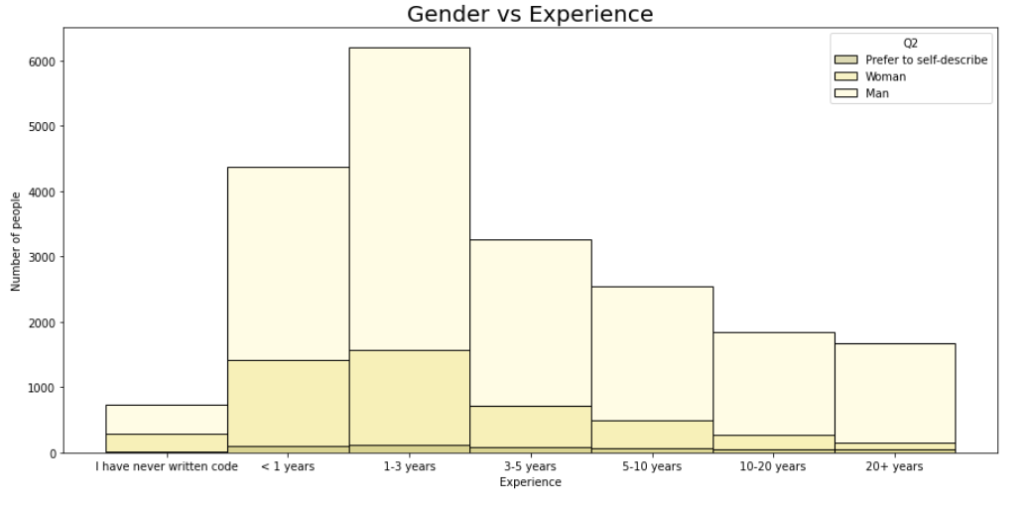
Gender vs Experience

Slide 6
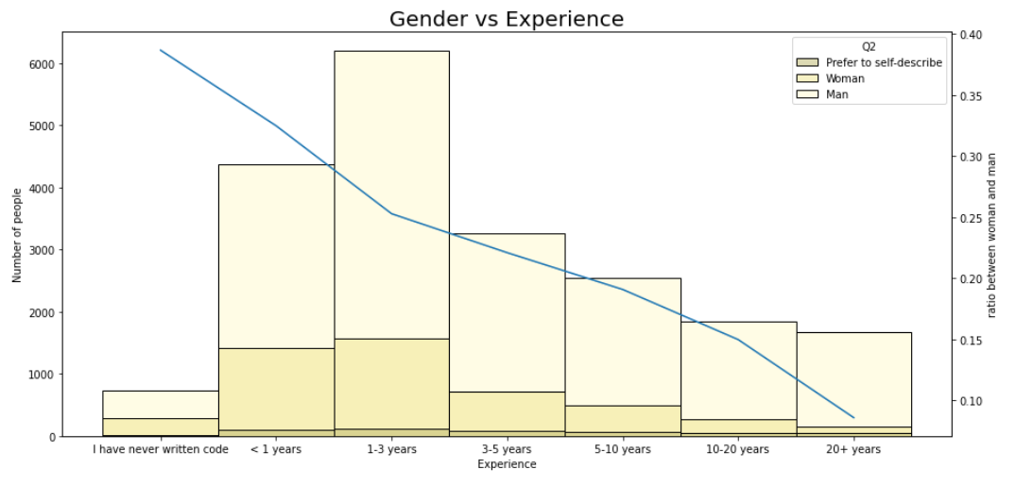
Gender vs Experience
Men
Women

Slide 7
Location vs Experience

Slide 8
Location vs Experience
For USA, the color tend to darken as the year of experience increases, meaning there are more seniors developers than juniors. This is due to the early development of technology in America.
For India, the color tend to lighten as the year of experience increases, meaning there are more juniors than seniors developers. This is because of the recent introduction of free internet and the late access to technology in India.

Slide 9
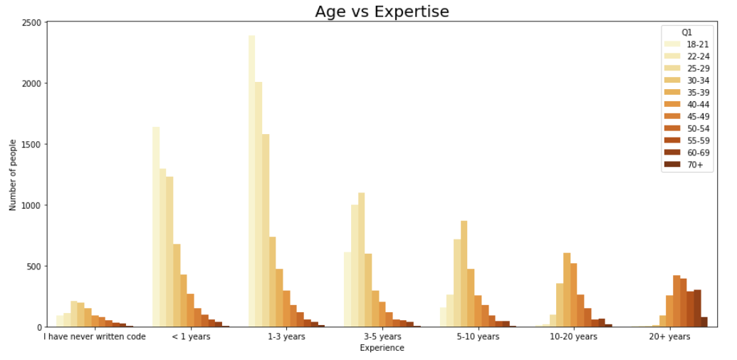
Age vs Experience
Color gets darker

Slide 10
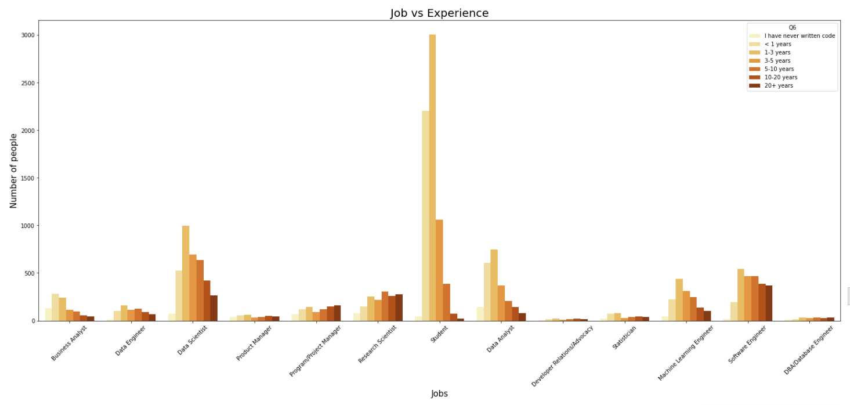
Jobs vs Experience
More than 3000 people
Less than a 1000 people

Slide 11
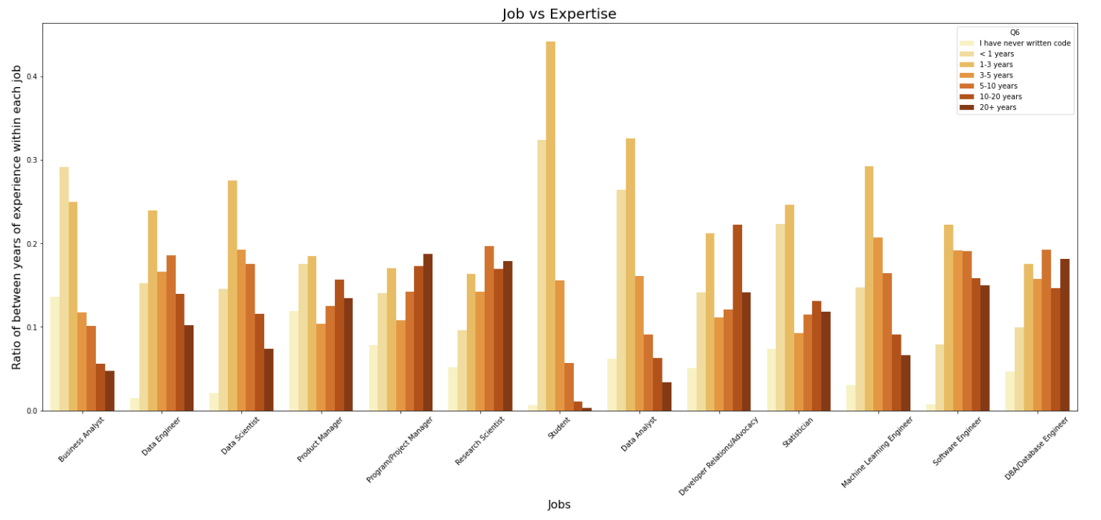
Jobs vs Experience

Slide 12
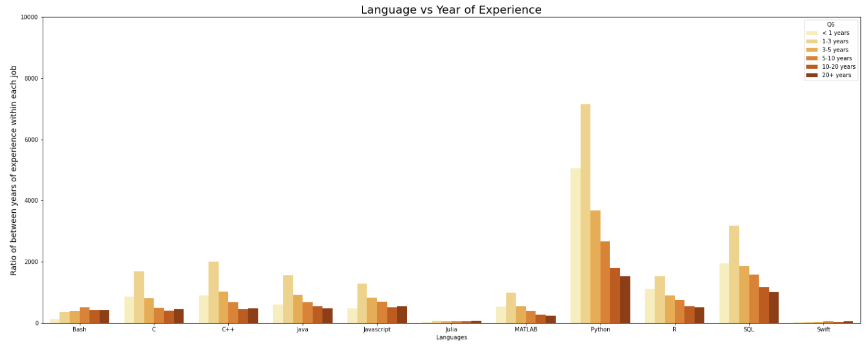
Language vs Experience

Slide 13
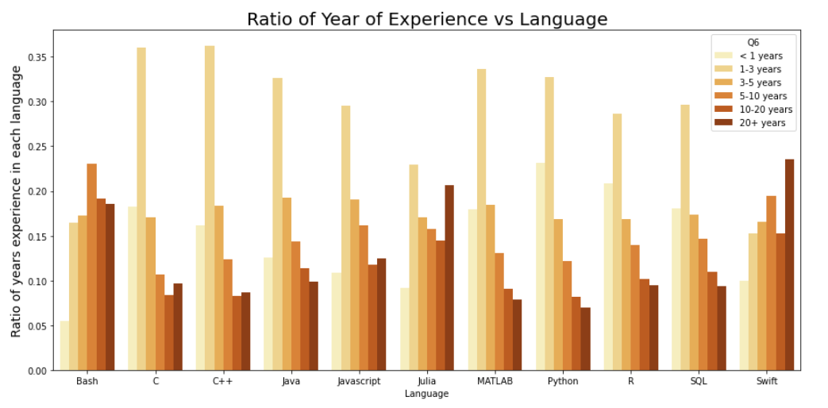
Language vs Experience

Slide 14
Conclusion
Gender: Men play a dominant role in the field of coding for a longer period of time while women did not have opportunity to learn earlier.
Location: USA has advanced technology through programming for many years while it has only been recent for India.
Ages: people around the age 25-29 want to switch to programming-related jobs due to many reasons (mainly because it's more applicable and more profitable in the modern world).

Slide 15
Conclusion
Jobs: Jobs like software engineer are popular and have adjustable skill ceilings. Jobs like Data Science, Machine Learning Engineer are new or require much less technical coding. Jobs like DBA, research scientists require extensive knowledge of programming.
Languages of Programming: Python is the most used language while Swift and Julia are least used. However, most experienced coders use Swifts and Julia. Most beginners use Python, R, SQL, and Matlab.

Slide 16
Body Fat Prediction
Nguyen Binh Nam

Slide 17
Quick Overview
The dataset emphasizes on each of the body fat, density and body parts’ sizes (such as Abdomen, density, body fat and etc). All of the values are numerical.
It also has only a few hundreds samples, which is relatively small.

Slide 18
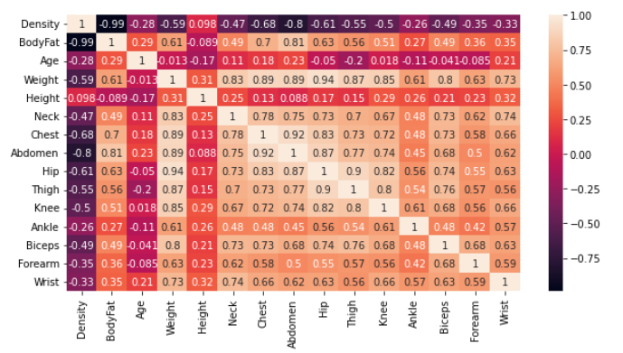
Correlation Matrix

Slide 19
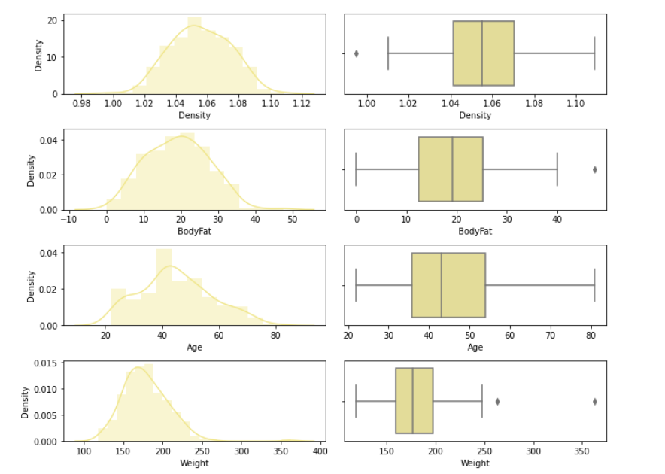
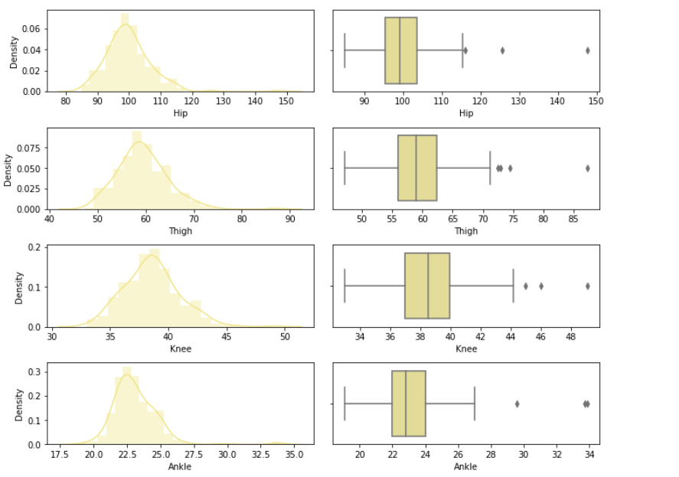
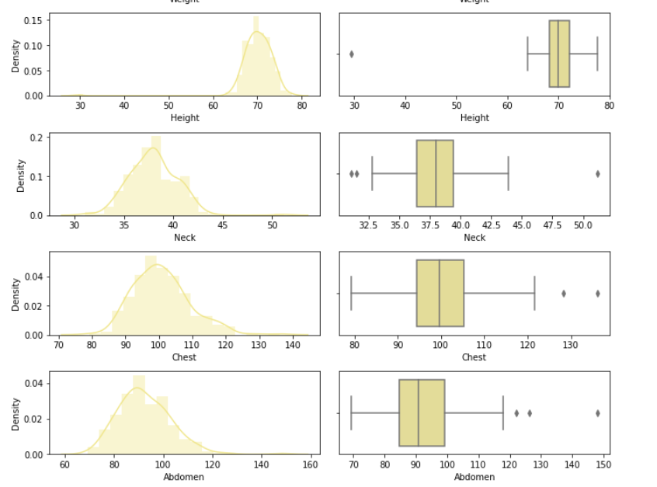
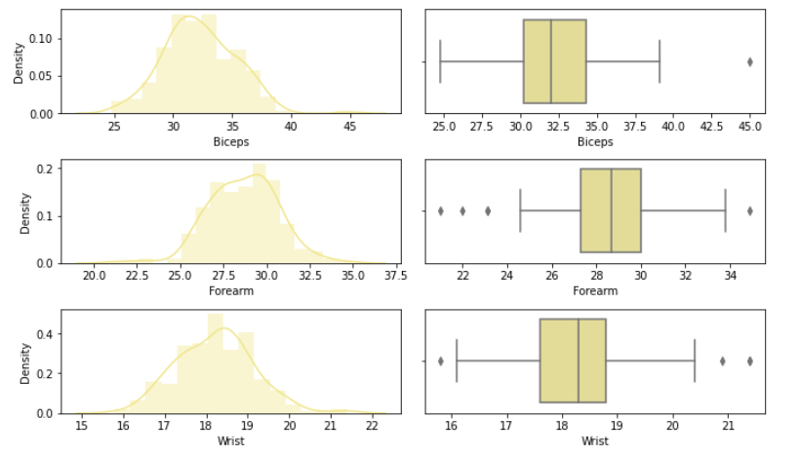

Slide 20
Objective and metrics
Objective
Creating an optimal model that can predict body fat of a person given the size of their body parts
Metrics
Regression problem: Target features are the size of different parts of the body and the label is the body fat. Classifiers used ( Bayesian Ridge, Random Forest Regressor, Linear Regression, and etc)

Slide 21
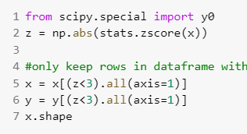
Data Preprocessing
Exclude Outliers
Using the z-score to determine and eliminate the outliers
Feature engineering
Combining weight and height into BMI and remove the columns Ankle and Hip in order to eliminate multicollinearity and optimize the learning model.

Slide 22
Splitting and Normalizing
Splitting data:
The test size is 0.25
Normalization:
I was using two different normalization methods:
MinMaxScaler
BoxCox (aborted because of the lower accuracy)

Slide 23
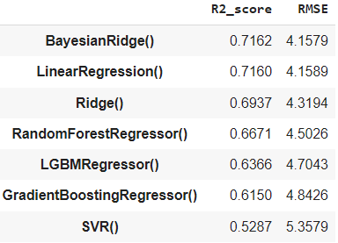
Modelling and Score Report

Slide 24
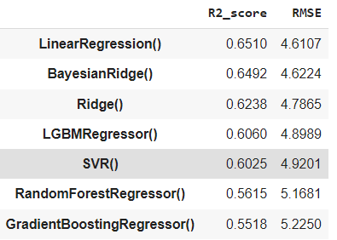
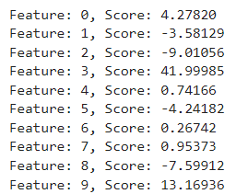
Feature Importance and why it failed
I used the linear regression feature importance to eliminate unnecessary features
After feature importance:

Slide 25
Conclusion
Data Preprocessing: Removing multicollinearity improves the performance
Normalization: MinMaxScaler normalize the dataset better than Box-Cox does
Classifier: BayesianRidge performed the best with the dataset (71 percent)
Feature importance: was irrelevant due to the low performance

Slide 26
Thank you for listening

